Slide 1



Hogeschool Vives
Educational Game
Presented by Olivier, Jasper, Xander en Esteban

Slide 2

Hogeschool Vives
Introduction
Our team, consisting of Esteban, Xander, Jasper, and Olivier, is excited to present our project, Joxe, a city-building experience that encompasses both a PC game and a board game, integrated through a central website.

Slide 3
Hogeschool Vives
Overview
01
Concept
04
Rapid Prototyping
02
Stakeholders
05
Challenges
03
Dividing the work
06
Solutions
07
Q&A

Slide 4

Hogeschool Vives
Concept
01
02
03
Pygame city builder
Pygame city builder
Board Game version
Interconnected Webpage
Pygame city builder
Board Game version
Interconnected Webpage
Integrated Lesson Plans

Slide 5
Hogeschool Vives
Stakeholders
SpellenLAB
Experts
Teachers

Slide 6
Hogeschool Vives
Dividing the work
Esteban
Jasper
Scrummaster
“Senior” PC game Dev
Sound designer
Asset designer
All rounder
Xander
Olivier
Web Developer
“Junior” PC game Dev
Project manager
Board game designer

Slide 7
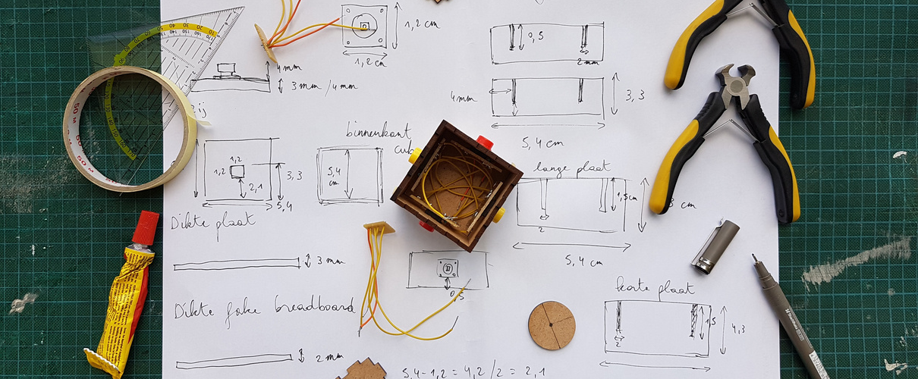
Hogeschool Vives
Rapid Prototyping
Weekly Internal Testing
Feedback Incorporation
Dynamic Adjustments
Expert Consultation
Github Kanban

Slide 8
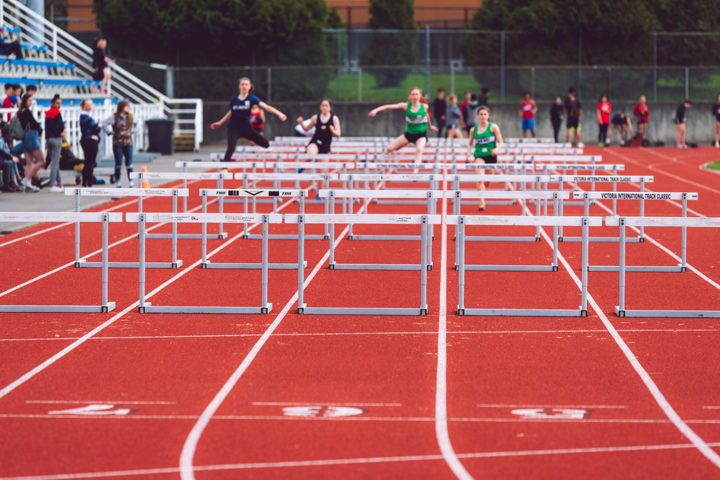
Hogeschool Vives
Challenges
Limited Experience
Time
Discord
Dependencies
Integration

Slide 9

Hogeschool Vives
Solutions
Limited Experience
Time
Discord
Dependencies
Integration
Keep PC-game as focus
Setting Priorities
Consensus
Risk Managment Plan
Website

Slide 10
Hogeschool Vives
Q&A
Presented by Olivier, Jasper, Xander en Esteban

Slide 11
Hogeschool Vives
Thank
You
Presented by Olivier, Jasper, Xander en Esteban

